Slide 1






Setting Priorities for UHC Session 2 Global Flagship Course on Health Systems Strengthening: The Challenge of Universal Health Coverage Nedim Jaganjac

Slide 2
Objectives of the session
Better understand different viewpoints for priority settings
Understand role of ethics and viewpoints of proponents of different policies
Systematically think about prioritizing pro-poor services
Understand vulnerability of your position for priority setting

Slide 3

Health System
Ministry of Health
Personal
Services
Sectors
Inter-sectoral action
Education
Population
Services
Health status
Financial protection
Patients satisfaction
Employment
Human capital and wellbeing
Agriculture
Fiscal Policy
Urban planning
…etc
Health systems encompass both personal and population services, and activities to influence the policies and actions of other sectors to address the social, environmental and economic determinants of health.

Slide 4
Three Pillars of Flagship Approach to Priority Settings
Technical analysis
Ethical analysis
Political analysis
Averages have limits.

Slide 5
The Role of Equity
Focusing on a nation’s average performance (e.g., the MGDs or the WHO Cube) misses the range of difference across geographic, income or ethnic groups
Improving the worst off may be most cost effective—basic care can produce large gains
However, serving geographically isolated or culturally resistant populations can be costly
Equity is complex:
differences between rich and poor
how badly off are the poor
Which kind of equity do we care about?

Slide 6
Poor Outcomes and Priority Setting: Which Ones Matter?
Health Status: Which conditions impose the greatest burden of ill health on the population, and which groups suffer most?
Financial Protection: Who pays the most out-of-pocket (relative to their income) for health care, and what do they spend that money on?
Citizen Satisfaction: Which aspects of the health system cause the most dissatisfaction, and who in society are the least satisfied with the current situation?

Slide 7
Ethical Theory and Priority Setting
Arguments about priority setting often invoke ethical and philosophical ideas—or are based on such ideas even if advocates don’t realize it
Understanding the underlying value systems (theories) can help clarify many common arguments and positions
Exploring alternative theories can also help each of us define our own positions
Understanding other theories can help us make arguments that others will agree with even if they don’t share our values.

Slide 8
Deciding How to Expand Coverage
Think about the health system goals of health status, financial protection, and citizen satisfaction – which one do you work on first?
Where does your health care system most fall short of providing the kind of life you want for your citizens?
Which groups do especially badly and how important is it to you to do something about that?
How can you improve “effective coverage” by acting on either the supply side (better provision) or the demand side (new insurance or financing)?
Which improvements would make the biggest difference in which actual outcomes?

Slide 9
Making Fair Choices About Health Services
Margaret Chan, previous DG at WHO (Chan, 2016):
“UHC means ensuring that everyone can obtain essential health services of high quality without suffering financial hardship. Resource constraints require countries to determine their own definition of essential. UHC cannot provide access to all possible health services….”
“In other words, choices must be made and priorities must be set….”
“ .. experiences suggest that no single, ideal institutional structure exists to guide priority setting for UHC. Each country has to decide what will best suit its needs, capacities, and the expectations of its citizens.”

Slide 10
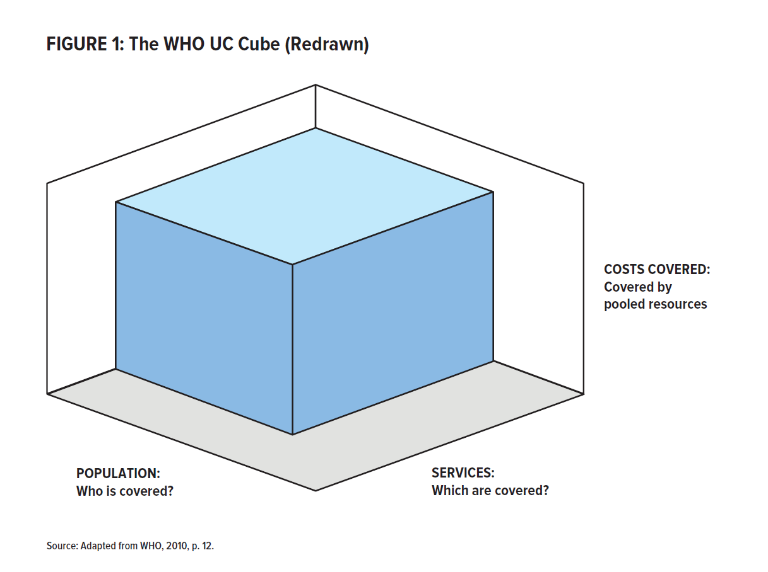
WHO “UHC Cube Diagram for services, coverage and financing”
COSTS COVERED:
How much is covered by pooled resources?
POPULATION:
Who is covered?
QUALITY SERVICES:
What are covered?
Source: Roberts, Hsiao, and Reich, 2015.

Slide 11
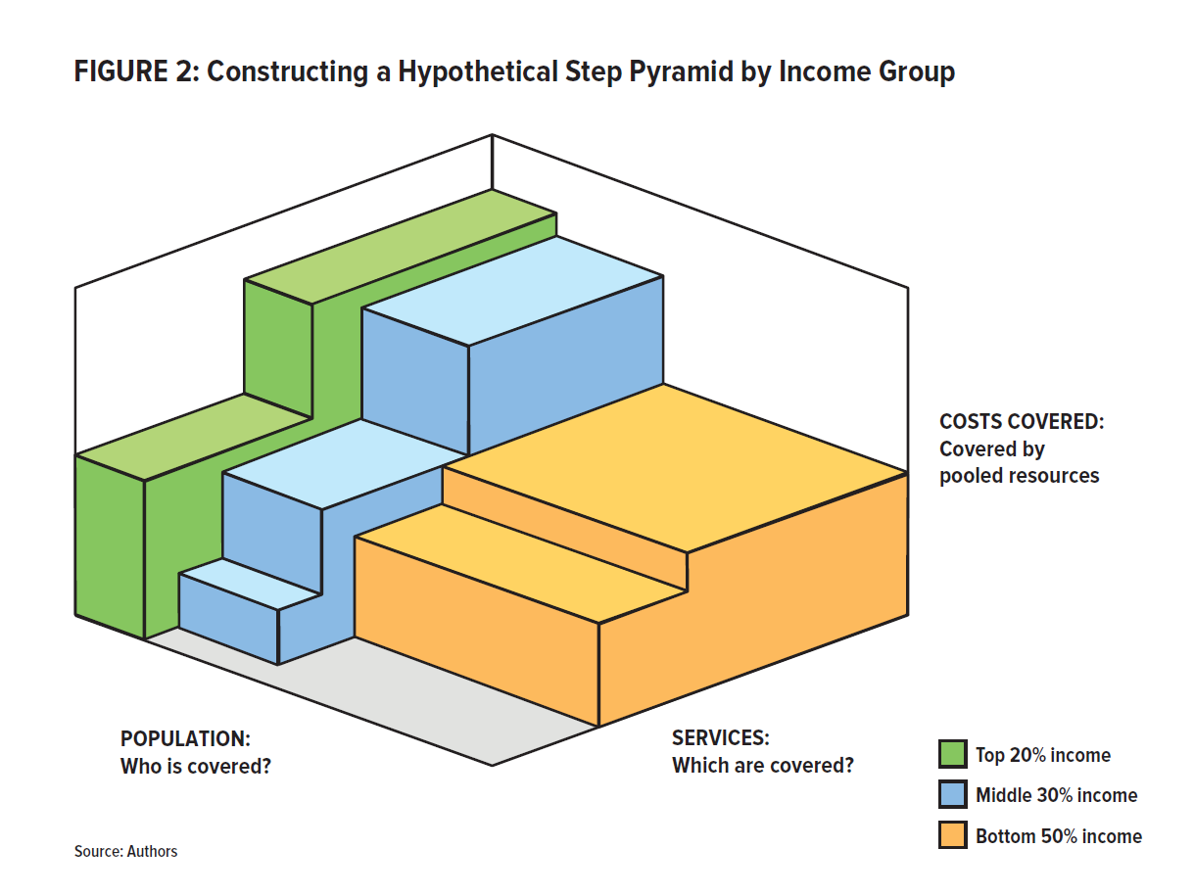
The Step Pyramid View of Coverage
A Hypothetical Step Pyramid by Income Group
COSTS COVERED:
How much is covered by pooled resources?
POPULATION:
Who is covered?
SERVICES:
What are covered?
Top 20% Income
Middle 30% Income
Bottom 50% Income
Source: Roberts, Hsiao, and Reich, 2015.

Slide 12
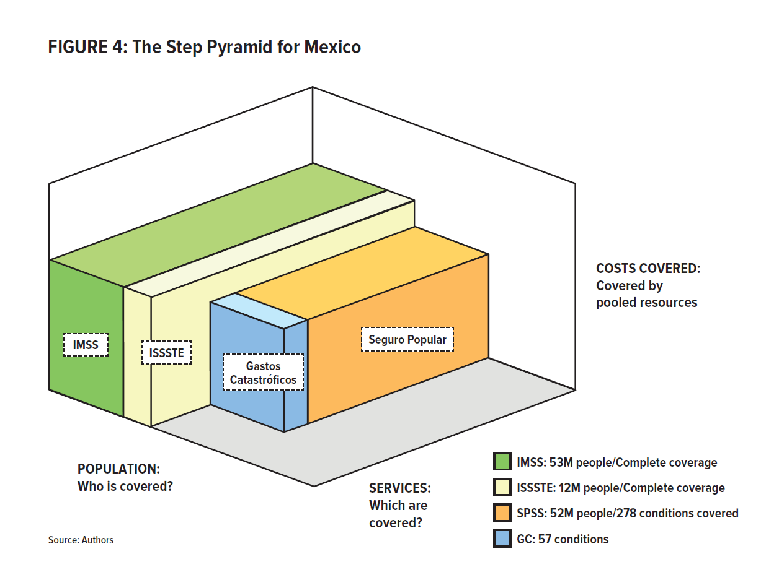
The Step Pyramid for Mexico
COSTS COVERED:
How much is covered by pooled resources?
IMSS
Seguro Popular
ISSSTE
Catastrophic Costs (GC)
POPULATION:
Who is covered?
SERVICES:
What are covered?
Source: Roberts, Hsiao, and Reich, 2015.

Slide 13
Using A Step Pyramid
Other sectors are not covered in the pyramid
Also it is assumed that these services are of high quality and that they contribute to patients satisfaction
Use the step pyramid diagram to ask: “What gaps do we want to ‘fill in’ first?”-- by expanding insurance coverage, improving services, or both
Choosing goals is a fundamental responsibility of national governments: a decision that both will and should reflect local politics and values

Slide 14
Making Choices is Unavoidable
Because health is highly multi-dimensional and because nations have limited resources, they must decide which conditions and groups to focus on first.
young versus the old (immunization vs cardiac surgery)
urban areas or hard-to-serve rural communities
cost-effective actions or saving those at imminent risk of dying
TB / HIV vs. NCDs
Pro-poor or pro-rich
Specific goals (e.g., lowering MDRTB) can improve targeting and implementation for specific groups, sometimes through ‘vertical’ programs; how does this produce Universal Health Coverage?
Reducing car accidents will involve transport sector

Slide 15
Exercise :
You have 100 patients and 50 pills. One pill will save the patient and cure the diseases. Others will die.
Who should get the pill?

Slide 16
A Brief Introduction to
Applied Philosophy

Slide 17
Three Theories Of Ethical Argument:
Consequences (where individuals end up)
Utilitarianism
Rights (where individuals start):
Liberalism
Virtue (individual character and social structure)
Communitarianism

Slide 18
Theory I: Utilitarianism
The goal of public policy should be to improve the overall well being of citizens
Individuals’ “utility levels” (satisfaction/happiness) are the relevant goals
Society should seek “the greatest good of the greatest number” – that is to maximize total utility
It is acceptable to infringe on rights, or sacrifice some individuals for the sake of others, if that is what it takes to achieve “the greatest good”

Slide 19
Implementing Utilitarianism
First, we have to predict the results of any proposed policy
Second, we need to measure the change in each person’s situation
Then, we need to add up the gains and losses
Both the number of gainers or losers, and the size of their gains or losses matter

Slide 20
Alternative Views of Individual Well Being
Subjective utilitarianism is based on how individuals feel— with goal of improving satisfaction/happiness (utility)
In practice, this approach measures “utility” by asking what people are willing to pay (market economists like this)
Objective utilitarianism is based on improving citizen’s measurable circumstances—like improving health status (public health experts like this)
Some groups of experts construct an index to measure health gains—like DALYs
One example of “objective utilitarianism” is the practice of clinical cost-effectiveness analysis

Slide 21
Theory II: Liberalism
There are Different Kinds Of Rights
Negative rights - The right to make choices about how to live (dress, food, work, sexual behaviour)—including freedom to control one’s own property
Positive rights - The right to a minimum level of income, shelter, education and health so that negative rights can be meaningfully exercised
Political rights - Speech, assembly, voting, etc. so that collective decisions are based on collective consent, not coercion

Slide 22
Two Views about Rights
Libertarians focus only on negative and political rights—including property rights (politically center right)
Egalitarian Liberals focus on all three kinds of rights: negative, positive and political rights (politically center left)
The more extensive the positive rights a society provides, the more it has to infringe on negative (property) rights to finance that redistribution

Slide 23
Theory III - Communitarianism
The goal of social policy should be to produce citizens who have the right character (virtue) and thus make morally correct choices for a particular community
Citizens need to participate in, and be bound together by, social institutions that reflect and reinforce those virtues.
These ideas have an impact on health policy about end-of-life issues, abortion etc.
Universal views (some religions, communists) vs. relativist views (protect unique communities)

Slide 24
Ethical Theory and Policy Choices for UCH Some Examples
Egalitarian liberals favor providing some minimum level of care and financial protection to all (regardless of cost) as a matter of basic rights
Objective utilitarians favor the use of cost-effective criteria to increase overall health status, and oppose ‘rule of rescue’ high-cost/low-yield care
Subjective utilitarians favor the use of free markets—so individuals can get what they are most willing to pay for and hence what will most increase their happiness

Slide 25
Three Pillars of Flagship Approach to Priority Settings
Technical analysis
Ethical analysis
Political analysis
Averages have limits.

Slide 26
Thinking About Priorities
What different priorities for health sector exist? Political? Technical?
Lets start with asking:
“What outcomes do you want to change to improve the well being of the individuals and families?”
In part this is a matter of values – deciding which health system outcomes are especially unsatisfactory (health, financial protection, satisfaction) for which specific groups (rich or poor etc)
It is also a matter of feasibility (what can you fix with available resources and capacities, and your ability to generate political support)

Slide 27
Let’s Look at the
Three Ultimate Performance Goals

Slide 28
UHC Goals and Health Sector
HEALTH STATUS: Since providing perfect health to all citizens is not possible, a nation must choose which aspects of ill health, among which population groups, to set as a priority. Don’t overlook prevention! Other sectors play important role in health!
FINANCIAL PROTECTION: This involves protecting against both the high costs of serious illness and the lower and more predictable costs of routine care.
CITIZEN SATISFACTION: While this is not a declared goal of UHC, political leaders inevitably consider this—especially in democratic settings

Slide 29
1. Health Status as a Goal
Burden of Disease: Which conditions cause the greatest burden of disease?
Benchmarking: Where do we do relatively poorly versus comparable countries in our region?
Solidarity/Equity: Which groups do particularly badly (for which conditions) and deserve special attention? (HIV, TB … hearth conditions?)
Political Concerns: Which problems are of most concern to key voters/supporters?

Slide 30
Measurement Matters
What data are available? Need to consider how good routine data are and whether they actually measure the problem or goal
What will it take to get better data? Need to consider the costs and benefits of getting better data
What data are persuasive to policy makers? Technicians often are convinced by data but policy makers may need other arguments.

Slide 31
Health Status: Tracking
Simple measures (IMR, MMR, life expectancy, most prevalent diseases) can be compiled more easily than complex metrics (DALYs, QALYs) but simplicity provides limited information
Information needs to be disaggregated by relevant groups, considering income, gender, region, or program
Defining and using a comprehensive health status index is challenging and costly
We need to account for various kinds of disability as well as death
We need to measure these effects over a lifetime
The needed data are often unavailable
These decisions involve important value choices
eHealth and electronic medical records can improve operations (real) data

Slide 32
2. Financial Protection as a Goal
Why is this an important goal?
Significant out-of-pocket health spending can harm well being, especially of those who are less well off
Unpredictable serious illnesses pose major economic risk to many families
The predictable costs of primary care (including medicines) can also be a serious burden
High cost prevent some form using health services
Providing risk protection against the costs of unpredictable illnesses is an insurance function
Providing financial well being in the face of costs related to predictable primary care is a form of re-distribution

Slide 33
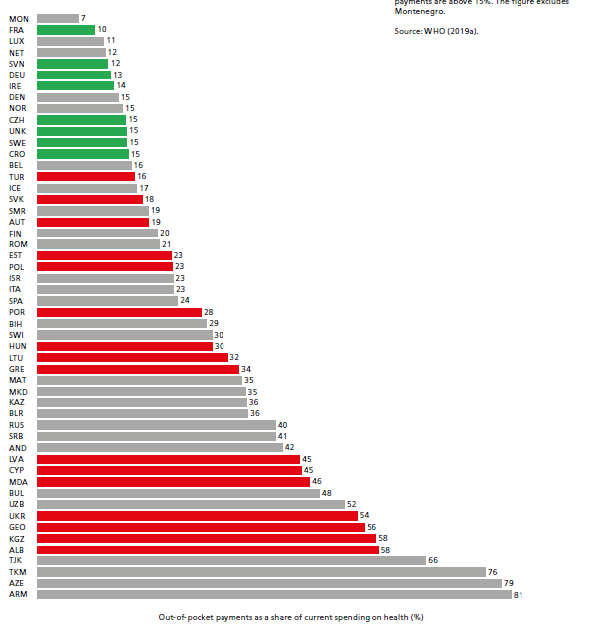
Out of Pocket Spending in ECA as a % of total spending for health
Source: WHO EURO 2019

Slide 34
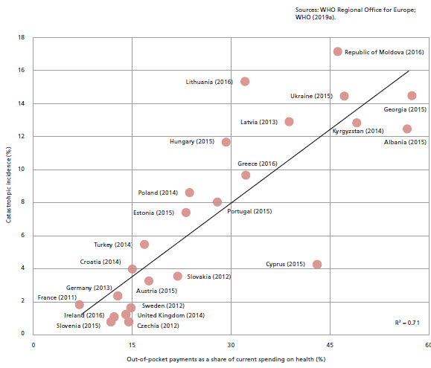

Slide 35
2. Financial Protection: Tracking
Household health expenditures can only be tracked by sophisticated—and expensive—household surveys
The costs to households of using health services takes various forms—formal and informal co-payments, transport costs, lost wages, etc.
Especially for poor households, one effect of lacking financial protection is to decrease use of care
Assessing the economic status of poor households is often not easy since they lack records and much of their income is typically in cash or kind.

Slide 36
3. Satisfaction as a Goal
Why is this an important goal?
Coverage expansions aimed at increasing satisfaction imply responding to what people want—rather than responding to what people need.
Those economists who want to allocate resources based on market demand are focused on this goal
Politicians also often respond to citizens’ satisfaction and dissatisfaction – as they should in a democracy
Satisfaction typically depends more on service quality (which citizens can judge) than on clinical quality (which they cannot judge easily)
Very relevant for integrated care – diabetes, hypertension are best managed by patient with support from medical professionals. Compliance with TB drug regime or adhering to immunization schedule is highly dependent on patients satisfaction.
Improving satisfaction may be key to reducing out of pocket spending and also improving health

Slide 37
3. Satisfaction: Tracking
Measuring satisfaction requires survey data —either from patients/customers of facilities or from populations
New technologies (cell phone messaging) offer new possibilities for at least registering complaints
Those with low expectations (e.g., the poor) may be more satisfied with low quality services
Those with more income maybe more satisfied because they can more easily get the services they want through the private sector

Slide 38
Wants (Satisfaction) vs Needs (Health)
Individuals’ choices may improve satisfaction but not their health
Overuse of brand name medicines and antibiotics, and underuse of chronic disease medications
Avoiding immunizations
Over-use of imaging technology, injections, antibiotics
Pushing for non-cost-effective ‘rescue medicine’
Raising basic questions about role of the Market
How far should the health care system go to:
Try to change such behavior?
Do what is best for the nation’s health even if citizens do not agree or favor other priorities?

Slide 39
Conclusions
Priority setting requires defining health system performance goals and measuring them: Health status, Financial protection, and Citizen satisfaction
Costs and equity (distribution) are important considerations in priority setting since there are never enough resources to meet all “needs”
Priority setting involves value choices that will benefit some groups and disadvantage others. Values vary from country to country, and reformers need ethical arguments to justify decisions about priorities

